Slide 1


KONGU ENGINEERING COLLEGE
PERUNDURAI ERODE-638060
DEPARTMENT OF CT-UG
ACADEMIC PROJECT
TITLE : Autoweave Enterprise Resource Management System
PROJECT DOMAIN : CONSULTANCY
PROJECT GUIDE : M.HEMALATHA
TEAM NUMBER : 02
TEAM MEMBERS : ENIGA.P(23BCR015)
GOPIKA.S(23BCR017)
SAMEEKA.N(23BCR046)

Slide 2
ABSTRACT
Auto-Weave is a centralized, web-based ERP tailored for the textile manufacturing industry, replacing fragmented legacy systems.
Integrates real-time production tracking, loom performance monitoring, and comprehensive workforce management (attendance, shift scheduling).
Streamlines order fulfillment, automates payroll, and enables secure payments via Razor-pay.
Provides actionable insights through advanced PDF/Excel reporting on defect rates, daily output, and plant efficiency.
Features a responsive React-based interface with Dark Mode, multi-language support (including Tamil), and robust Role-Based Access Control (RBAC).

Slide 3
PROBLEM DEFINITION
Inefficient Production Tracking
Reliance on manual entries for daily meter production causes data errors.
Fragmented Worker Management
Paper-based tracking of attendance and shifts lacks transparency.
Lack of Integrated Financials
Payment processing is disconnected from attendance records.
No Data-Driven Decisions
Absence of a consolidated dashboard prevents a bird's-eye view of mill health.

Slide 4
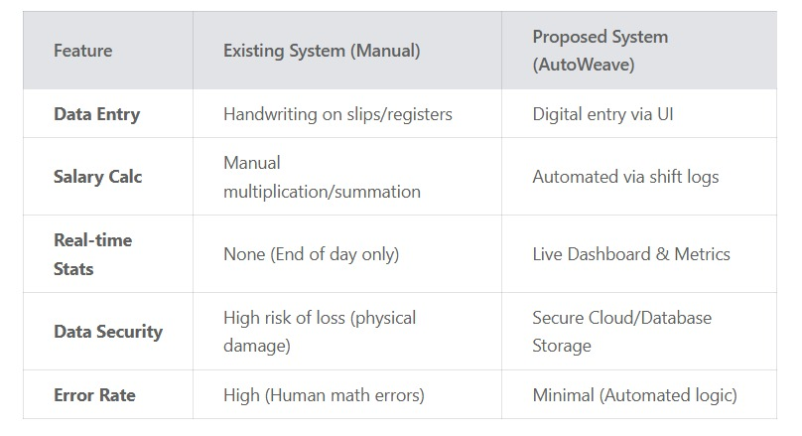
COMPARISON BETWEEN EXISTING SYSTEM AND PROPOSED SYSTEM

Slide 5
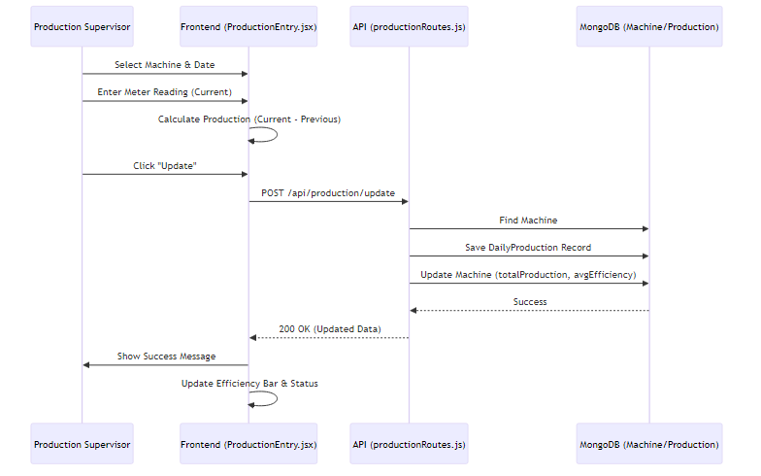
SEQUNCE DIAGRAM:
PRODUCTION TRACKING

Slide 6
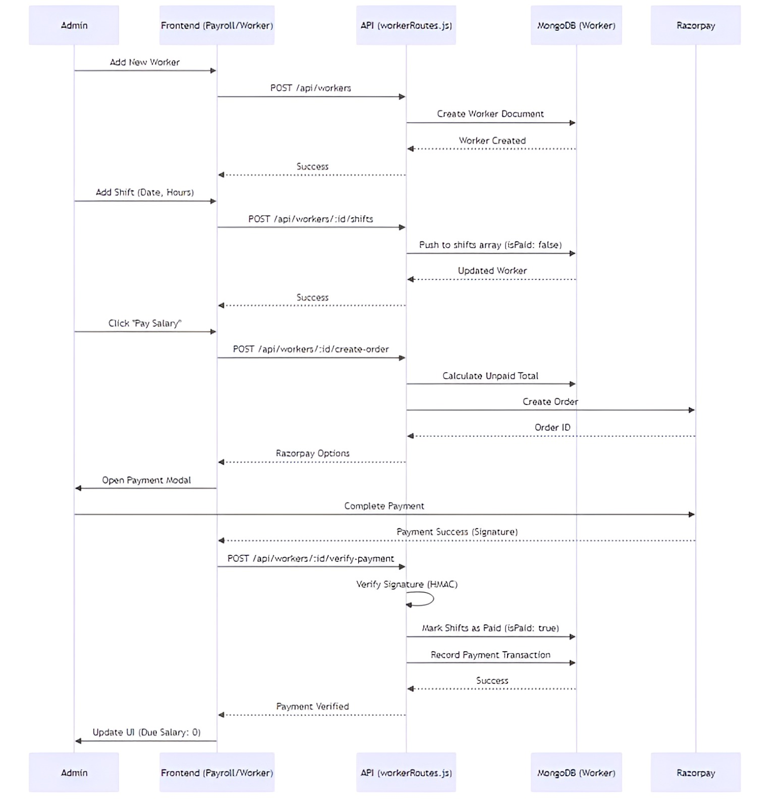
WORKER AND PAYROLL

Slide 7
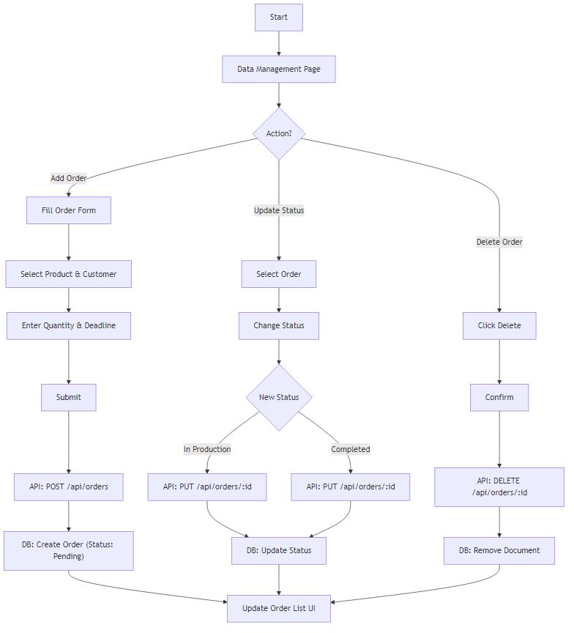
SYSTEM FLOW DIAGRAM:
ORDER MANAGEMENT

Slide 8
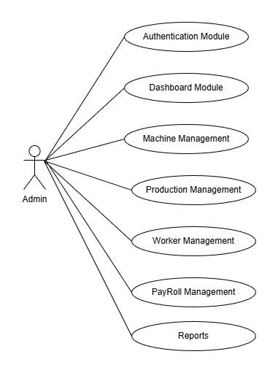
USE CASE DIAGRAM

Slide 9
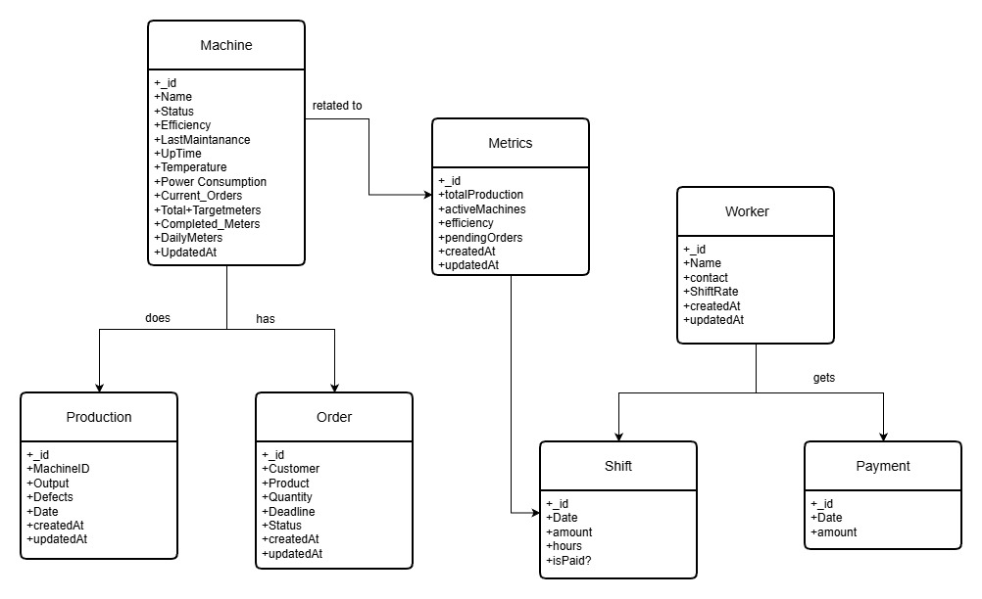
CLASS DIAGRAM

Slide 10
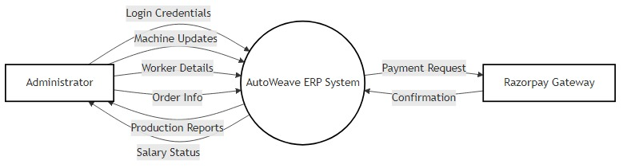
DATA FLOW DIAGRAM LEVEL 0

Slide 11
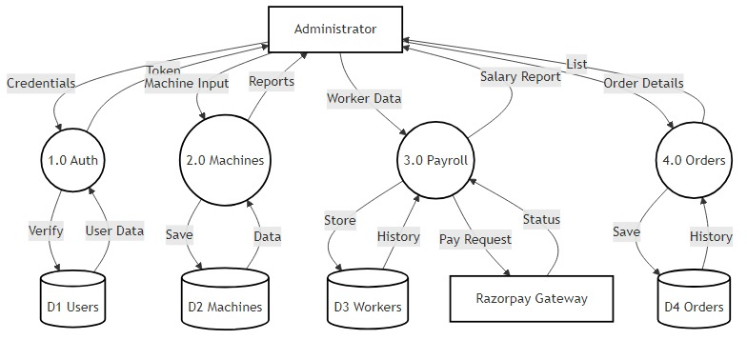
DATA FLOW DIAGRAM LEVEL 1

Slide 12
MODULE SPECIFICATION
AUTHENTICATION MODULE:
To ensure secure access to the system and protect sensitive production and payroll data.
Key Features: Secure Login/Logout functionality.
MACHINE MANAGEMENT MODULE:
Purpose: To track the status, efficiency, and production output of every loom in the factory.
Production Logging
Automated Calculations
Status Monitoring
WORKER AND PAYROLL MODULE:
To manage the workforce and automate salary distribution.
Maintain profiles with contact info and base shift rates.
Shift Management: Record daily attendance/shifts.
Payroll Processing: Automated calculation of due salary (Unpaid Shifts × Shift Rate).
Payment Integration: Digital payout via Razorpay and manual cash entry recording.

Slide 13
ORDER MANAGEMENT MODULE:
Purpose: To manage customer demands and ensure production alignment with deadlines.
Customer Records: Store customer names and specific product requirements.
Quantity Tracking: Track orders in meters or relevant textile units.
Track order lifecycle (Pending → In Production → Completed).
Deadline Monitoring
DASHBOARD AND REPORTS MODULE:
Purpose: To provide a high-level visual summary of the entire manufacturing operation.
Key Features: Metrics Overview: Display total production, active machines, and overall mill efficiency.
Visual Data: Charts for shift distributions and production trends.
Status Snapshots: Quick-view counters for pending orders and worker stats.

Slide 14
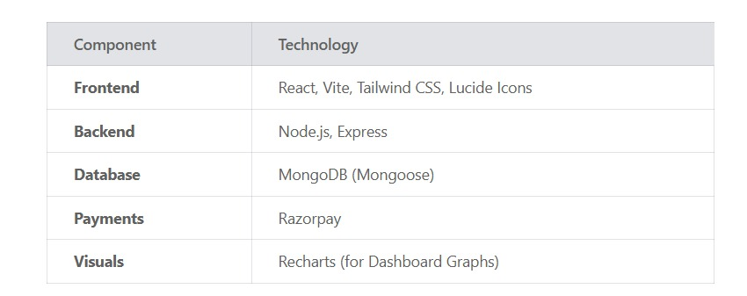
TECHNOLOGIES USED

Slide 15


Thank You !!

